Slide 1
Quality

Slide 2
Objectives
What we will tak about in this session
Understand why Quality is important
Identify and use static analytic tools
Understand the concept of technical debt and coverage
Understand the different components of Sonar
Configure a SonarQube server
Analyze a project using SonarQube
Notes:
Instructor Notes:
Discuss the objectives and the key points that will be covered in this session.

Slide 3
A need for Quality
Business applications have long lives.
They change and evolve over time
Business changes
New features
Bug fixes
Several people or even companies can work on an application during its lifespan
Applications tend to become more complex over time
Code quality tends to drop with developers turnover and quick fixes
Technical debt increase over time and can lead to the death of the application
Notes:
Browse through the Maven repository to show them the structure

Slide 4
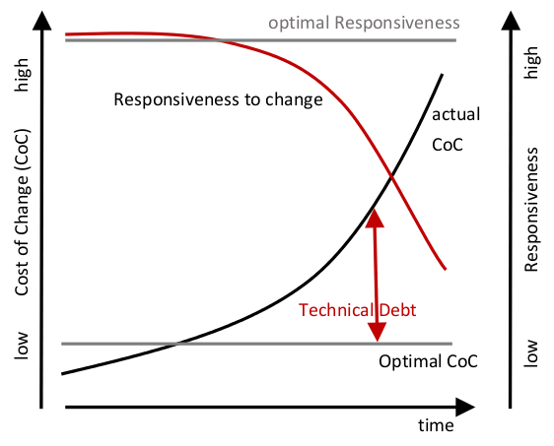
Technical Debt
A concept in software development that reflects the implied cost of additional rework caused by choosing an easy solution now instead of using a better approach that would take longer
Technical debt has to be managed and reduced by ensuring that the application is coded the right way.
Refactoring is a common practice to reduce technical debt and thus increase maintainability of our codes and applications.

Slide 5
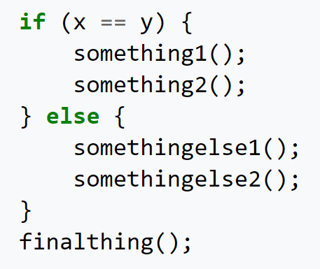
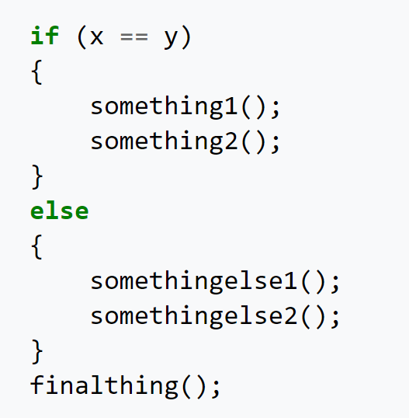
The right way
OR

Slide 6
Challenges of working within a team
Every developer has his own right way of coding.
Need for consistency to achieve maintanability.
A common coding practice needs to be adopted and shared throughout the team.
Java conventions
Oracle: http://www.oracle.com/technetwork/java/codeconventions-150003.pdf
Google: https://google.github.io/styleguide/javaguide.html

Slide 7
What is code quality ?
Code quality is a loose approximation of how useful and maintainable the code is on the long term.
Code quality is subjective.
Good code has some common characteristics which ensure a good maintainability over time

Slide 8


Code quality : Functional quality vs Structural quality
Functional quality
Refers to how well a software complies to:
a given design
functional requirements
specifications
Structural quality
Refers to how well a software complies to:
non-function requirements
robustness and maintainability

Slide 9
Characteristics of quality code
Comprehensible
Code should be easy to reason about at all levels. Ideally, software should be so simple that there are obviously no deficiencies.
Testable
Testable code tends to be composed of smaller pieces, have well-defined interfaces, be less coupled to other parts of the system, have fewer side effects and tends to have less mutable state.
Correct
Should meet both functional and non-functional requirements. It is much easier to correct defects in comprehensible and testable code than it is to make defect-free code testable.
Efficient
Code should make efficient use of system resources (memory, CPU, network connection, etc.). Code should be written in such a way that its efficiency matches O(1).

Slide 10
Code quality tools
Code quality tools are used throughout the development cycle to present a continuous view of structural code quality.
before commits as IDE plugins and provide real-time analysis while coding.
before commits and invoked by a tool like Maven at compile/build time.
after commits and invoked by a CI platform like Jenkins.

Slide 11
Code quality tools
Code quality tools can be categorised into one or more of the following:
check conventions
avoid using bad practices
find potential bugs
check architectural issues
measure code coverage

Slide 12
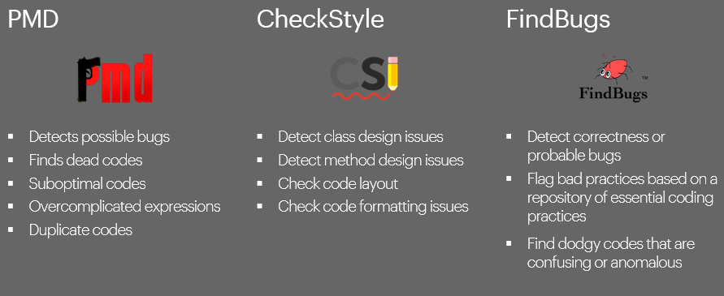
Java Code Quality tools – The classics

Slide 13
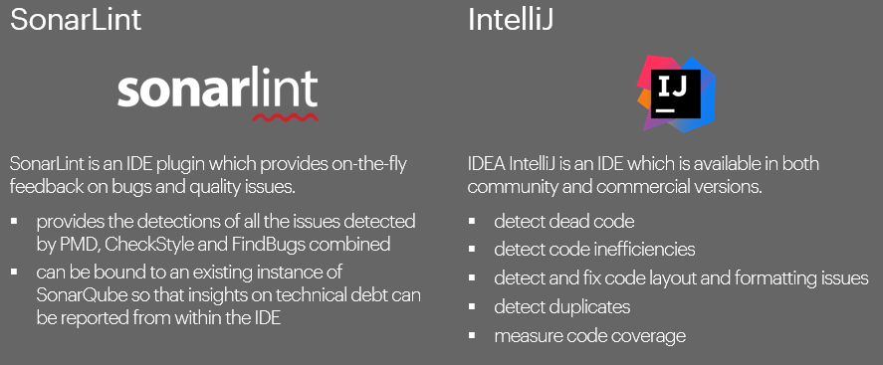
Java Code Quality tools – Recent additions

Slide 14

SonarQube
One of the most widely used tool for continuous code inspection.
Triggered by a CI Tool such as Jenkins after code commits.
Detects bugs, code smells and security vulnerabilities.
explores all possible execution paths and provides detailed reports on code coverage
provides a comprehensive dashboard on the overall health of an application

Slide 15
SonarQube
In SonarQube, alerts are categorized as follows :
Bugs
Vulnerability
Code smells
In previous versions of SonarQube, we had the following categorizations :
Blocker
Critical
Major
Minor

Slide 16
SonarQube
A scale of A – E is also given on our SonarQube server dashboard.
A being the best score
E being the worst score.
When we talk about Bugs, we often talk about the reliability of our applications.
When we talk about Vulnerabilities, we evoke the security of our applications
When we talk about Code Smells, we talk about the maintainability of our applications.

Slide 17
SonarQube Rules - Bugs
Bugs (Not compilation errors)
Null pointers should not be dereferenced
Example : Having a variable/object which was explicitly created as null and not checking null before using it.
What could result from this?
Loops should not be infinite
Example : Creating a while loop with a boolean variable inside and it always return true.
What could result from this?
Exception should not be created without being thrown
On SonarQube, we can retrieve such list by navigating to the “Rules” tab.

Slide 18
SonarQube Rules - Vulnerabilities
Vulnerabilities (Problems that can affect our application’s security)
Credentials should not be hard-coded
What security problem could result from this?
Throwable.printStackTrace() should not be called
Example : e.printStackTrace
What security problem could result from this?
On SonarQube, we can retrieve such list by navigating to the “Rules” tab.

Slide 19
SonarQube Rules – Code Smells
Code smells (Maintainability – Code not abiding by java conventions)
NullPointerException should not be thrown or caught
Short-circuit logic should be used in boolean context
Example : Use && or || instead or & or |
On SonarQube, we can retrieve such list by navigating to the “Rules” tab.

Slide 20
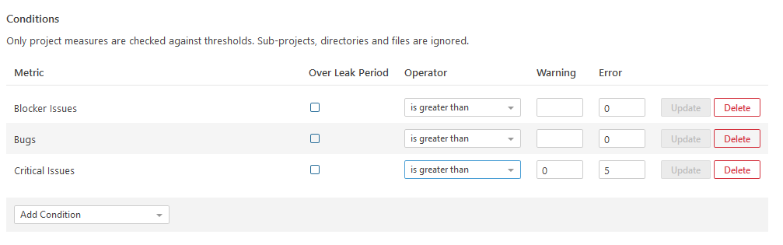
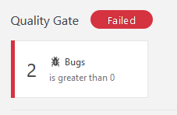
SonarQube – Quality Gate
A quality gate is the best way to enforce a quality policy in your organization.
We can add conditions in order to enforce this quality check

Slide 21
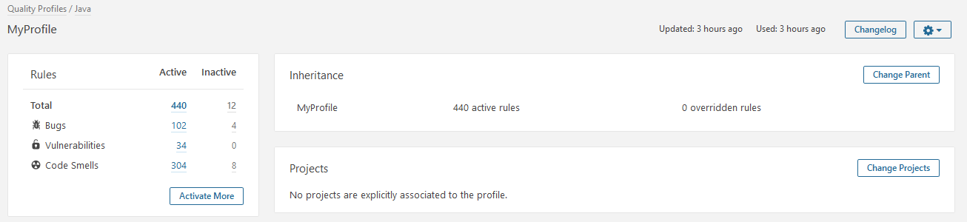
SonarQube – Quality Profile
When we talk about quality profile, we talk about the different rules we want our code to abide to
We can easily configure the set of rules to be used during the analysis of our application

Slide 22
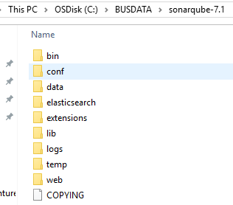
SonarQube – Installation the server
Checkout/download the “sonarqube-7.1.zip” file on your respective workstations
Unzip the sonarqube-7.1.zip file
The SonarQube server comes with an embedded database. However, it is highly recommended to use an external database
Oracle
MySQL
PostgreSQL
SQLServer

Slide 23
SonarQube – Installation the server
To configure your external database, open the sonar.properties file, found in the conf directory
In this file, we can easily configure the sonar.jdbc.url property to specify the database we want to use
In order for SonarQube to gain access to our specified database, a connector should be used and must be present in the lib/jdbc folder.
By default, SonarQube server comes with mysql and postgresql connectors.
For oracle, we must download the ojdbc.jar connector.

Slide 24

SonarQube – Installation the server
To start our sonar service/application, we first navigate to the bin directory and choose a folder based on our currently operated OS on our machine
For example : If we are using Windows 64-bit, we navigate to the windows-x86-64 folder
To start our SonarQube server :
We open a cmd window in our current directory
We execute the StartSonar.bat file
To access our SonarQube server, we simply navigate to the following link on our browser :
http://localhost:9000/
By default, the administrator password will be admin/admin
It can be changed on the MyAccount window > Security tab

Slide 25
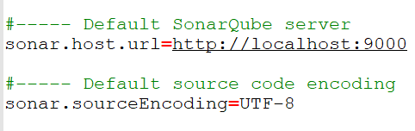
SonarQube – Scanning a java project
In order to scan our project, we need to use a scanner or a continuous integration tool (like Jenkins)
Download and unzip the “sonar-scanner-3.2.0.1227-windows.zip” file
Add the bin folder to your environment variables in order to use the sonar-scanner.bat file
Before being able to use the scanner, we first need to configure its sonar-scanner.properties file, found in the conf folder.
In this file, we need to specify the link to our SonarQube server.

Slide 26
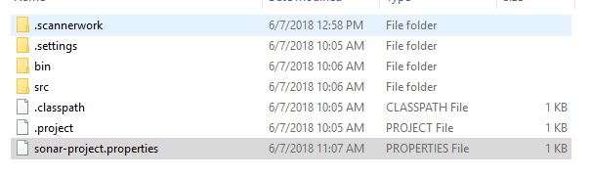
SonarQube – Scanning a java project
To scan our project, we first need to navigate to the root folder of our project and create a sonar-project.properties file
In this file, we need to specify the following:
sonar.projectKey
sonar.projectName
sonar.projectVersion
sonar.sources
sonar.java.binaries
A list of supported parameters can be found : https://docs.sonarqube.org/display/SONAR/Analysis+Parameters

Slide 27
SonarQube – Scanning a java project
To launch the scanner, we need to open a cmd window in the root directory of our project and launch the command sonar-scanner
When the execution is over, we can verify our results in our SonarQube server.

Slide 28

www.menti.com
Code : 627402
Notes:
15 minutes for mini quiz in game form (with points ☺ )

Slide 29

You currently own a business and you need to develop a website to further its growth.
What are the contents you think would add value to your website?
Notes:
15 minutes for mini quiz in game form (with points ☺ )

Slide 30


SonarQube versus Sonarlint
Central Server for analyzing codes
Usually takes time depending on the size of the project
Analyses the whole project
Can be automated
Analyser found in the IDE which can connect with SonarQube server OR can use its own rules
Instantaneous results (on the fly)
Can analyse the whole project as well as one class.
Notes:
Analysis of these tags

Slide 31
Sonarlint
Sonarlint is the official plugin of SonarSource.
It allows us to visualize coding alerts/defects immediately on our IDE.
It is a plugin for the developers
Available on the following IDE:
Eclipse
IntelliJ
Visual Studio
Prerequisits for using Sonarlint is :
Java 8
Eclipse Kepler or above
SonarQube 5.6+ (in order to use the connected mode)
It can be downloaded on Eclipse Marketplace
Notes:
Analysis of these tags

Slide 32
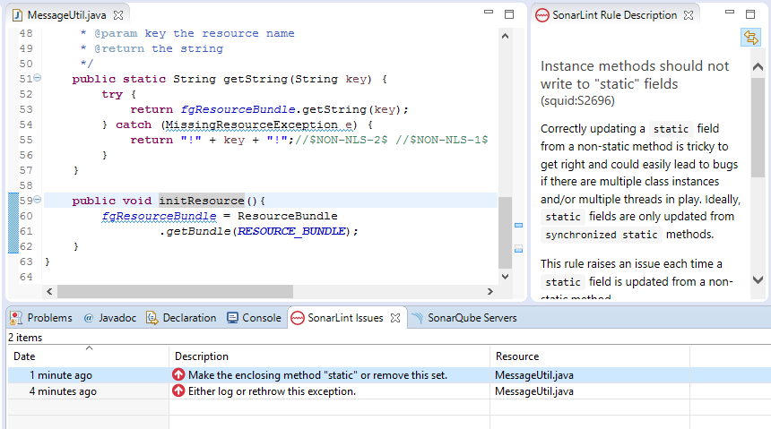
Sonarlint
SonarLint shows the different alerts directly in our codes, by highlighting them.
It also gives us the description of the alert in the view section
copyright © 2016 Accenture All rights reserved.

Slide 33
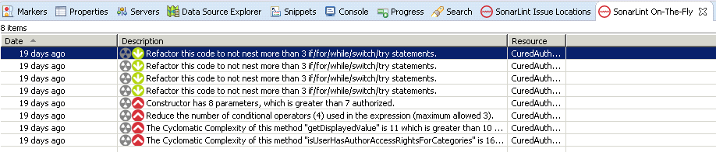
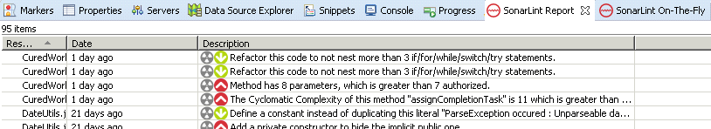
Sonarlint – Types of analysis
SonarLint has 2 types of analysis :
On the Fly
Whole Project
The « On the Fly » analyze only the file we just modified and saved and allows us to rapidly correct any defects we introduced
The « Whole Project » mode analyses our whole application
copyright © 2016 Accenture All rights reserved.

Slide 34
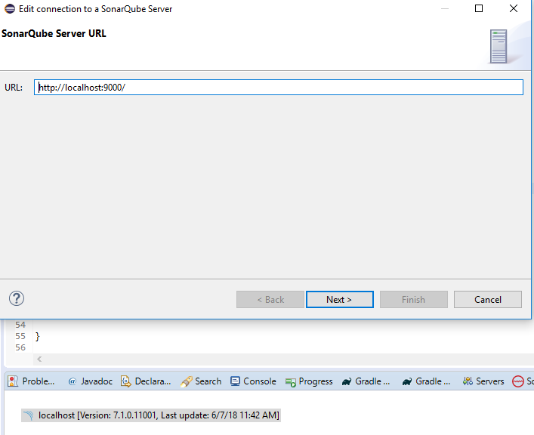
Sonarlint – Connected mode
SonarLint has its own sets of rules. However, we can easily configure them by connecting Sonarlint to our SonarQube server.
copyright © 2016 Accenture All rights reserved.

Slide 35
Further Materials (References)
https://docs.sonarqube.org/display/SONAR/Documentation
https://docs.sonarqube.org/display/SONAR/Analysis+Parameters
https://www.octo.com/fr/publications/20-culture-code
Notes:
Analysis of these tags

